Slide 1


HOME ABOUT US PROBLEM WE TREAT SERVICE PRODUCTS CONTACT
Eproject SEM 1
Group 04 – Batch 172
Instructor: Ths Le Quoc Dung
Member: Ngo Anh Hao (leader)
Pham Phu Cuong

Slide 2
HOME ABOUT US PROBLEM WE TREAT SERVICE PRODUCTS CONTACT
TABLE OF CONTENT
I
Introduction
II
Project planning
III
System analysis and design
IV
Technical

Slide 3
HOME ABOUT US PROBLEM WE TREAT SERVICE PRODUCTS CONTACT
TABLE OF CONTENT
V
Advantages, disadvantages, and oriented development
VI
Gui of website
VII
Referencs

Slide 4
HOME ABOUT US PROBLEM WE TREAT SERVICE PRODUCTS CONTACT
I
Introduction

Slide 5
HOME ABOUT US PROBLEM WE TREAT SERVICE PRODUCTS CONTACT
I
Introduction
ZaraTherapyClinic is a website developed with the aim of helping patients find out detailed information about the disease they suffer from, the website also displays information on solutions to help prevent and cure, the website also sells some skin care, beauty and some modern equipment. In addition, ZaraTherapyClinic also has relaxation services such as massage, skin care,...

Slide 6
HOME ABOUT US PROBLEM WE TREAT SERVICE PRODUCTS CONTACT
II
Project planning

Slide 7
HOME ABOUT US PROBLEM WE TREAT SERVICE PRODUCTS CONTACT
No. | Work | Member | Start | End
1 | Navbar | Hao | 7-8-2022 | 7-8-2022
2 | Footer | Hao | 9-8-2022 | 9-8-2022
3 | Home page | Hao | 8-8-2022 | 9-8-2022
4 | Contact page | Hao | 14-8-2022 | 14-8-2022
5 | Login page | Hao | 10-8-2022 | 10-8-2022
6 | Sign up page | Hao | 11-8-2022 | 11-8-2022
7 | Service page | Hao | 13-8-2022 | 13-8-2022
8 | Service detail page | Hao | 13-8-2022 | 13-8-2022
9 | Products page | Hao | 14-8-2022 | 14-8-2022
10 | Products detail page | Hao | 14-8-2022 | 14-8-2022
11 | DiscSyndrome page | Hao | 12-8-2022 | 12-8-2022
12 | Sciatica page | Hao | 12-8-2022 | 12-8-2022
13 | NeckPain page | Hao | 12-8-2022 | 12-8-2022
14 | Headaches page | Hao | 12-8-2022 | 12-8-2022
15 | Foot page | Hao | 12-8-2022 | 12-8-2022
16 | Elbow page | Hao | 12-8-2022 | 12-8-2022
17 | Wirst page | Hao | 12-8-2022 | 12-8-2022
18 | Low page | Hao | 12-8-2022 | 12-8-2022
19 | Scoliosis page | Hao | 12-8-2022 | 12-8-2022
20 | Knee page | Hao | 12-8-2022 | 12-8-2022
21 | ShoulderPain page | Hao | 12-8-2022 | 12-8-2022
22 | Ankle page | Hao | 12-8-2022 | 12-8-2022
23 | Contact page | Hao | 15-8-2022 | 15-8-2022
24 | Cart page | Hao | 16-8-2022 | 17-8-2022
25 | Started page | Hao | 9-8-2022 | 9-8-2022
26 | Chiropractic Adjustment | Cuong | 12-8-2022 | 12-8-2022
27 | Pneumex PneuBack | Cuong | 12-8-2022 | 12-8-2022
28 | ClassIVLaser Therapy | Cuong | 12-8-2022 | 12-8-2022
29 | ShockWave Therapy | Cuong | 12-8-2022 | 12-8-2022
30 | Vertetrac | Cuong | 12-8-2022 | 12-8-2022
31 | Foot Orthortics | Cuong | 12-8-2022 | 12-8-2022
32 | Physiotherapy and Cervico 2000 | Cuong | 12-8-2022 | 12-8-2022
33 | DTSDecompressionTractionTherapy | Cuong | 12-8-2022 | 12-8-2022
34 | Manual-Therapy | Cuong | 12-8-2022 | 12-8-2022
35 | Active-Therapeutic-Movement | Cuong | 12-8-2022 | 12-8-2022
36 | About us page | Cuong | 12-8-2022 | 12-8-2022

Slide 8
HOME ABOUT US PROBLEM WE TREAT SERVICE PRODUCTS CONTACT
III
System analysis and design

Slide 9

HOME ABOUT US PROBLEM WE TREAT SERVICE PRODUCTS CONTACT
USE CASE
III
System analysis and design
View page
View information
Service
Book service
Products
Information products
Guest
Sign up/ Sign in
Cart
Contact
Buy

Slide 10
HOME ABOUT US PROBLEM WE TREAT SERVICE PRODUCTS CONTACT
USE CASE
III
System analysis and design
Customer manager
Login
Order processing
Admin
Service

Slide 11
HOME ABOUT US PROBLEM WE TREAT SERVICE PRODUCTS CONTACT
SITE MAP
III
System analysis and design
About us
Problem We Treat
…
Home Page
Combined Therapies
…
Service
Beauty page
Booking
Products
Product detail
Cart
Add to cart
Contact
Sign up/ Sign in
Buy

Slide 12
HOME ABOUT US PROBLEM WE TREAT SERVICE PRODUCTS CONTACT
SITE MAP
III
System analysis and design
Disc Syndrome
Sciatica
Neck Pain
Headaches
Home Page
Problem We Treat
Foot Problem
Elbow Pain
Wrist Pain
Low Back Pain
Scoliosis
…

Slide 13
HOME ABOUT US PROBLEM WE TREAT SERVICE PRODUCTS CONTACT
SITE MAP
III
System analysis and design
Chiropractic Adjustment
Pneumex PneuBack
Class IV Laser Therapy
Shockwave Therapy
Home Page
Combined Therapies
Vertetrac and Cervico 2000
Foot Orthotics
Physiotherapy
DTS Decompression TractionTherapy
Manual Therapy
Active Therapeutic Movement(ATM2)

Slide 14
HOME ABOUT US PROBLEM WE TREAT SERVICE PRODUCTS CONTACT
LAYOUT

Slide 15
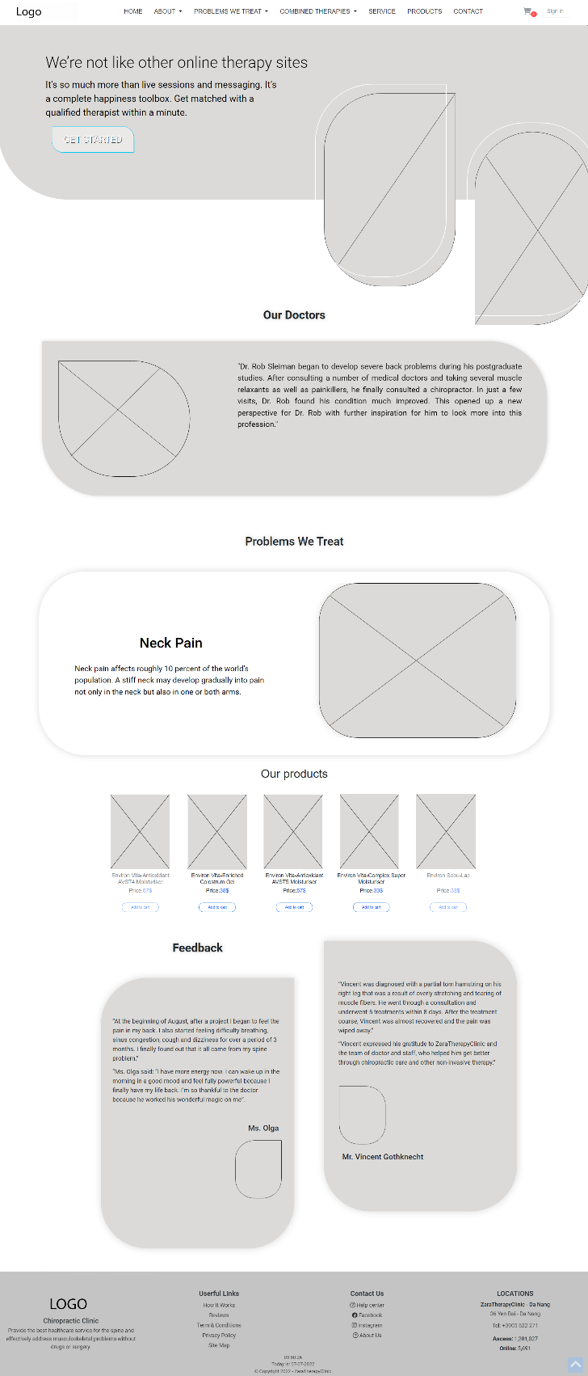
HOME ABOUT US PROBLEM WE TREAT SERVICE PRODUCTS CONTACT
Home page layout

Slide 16
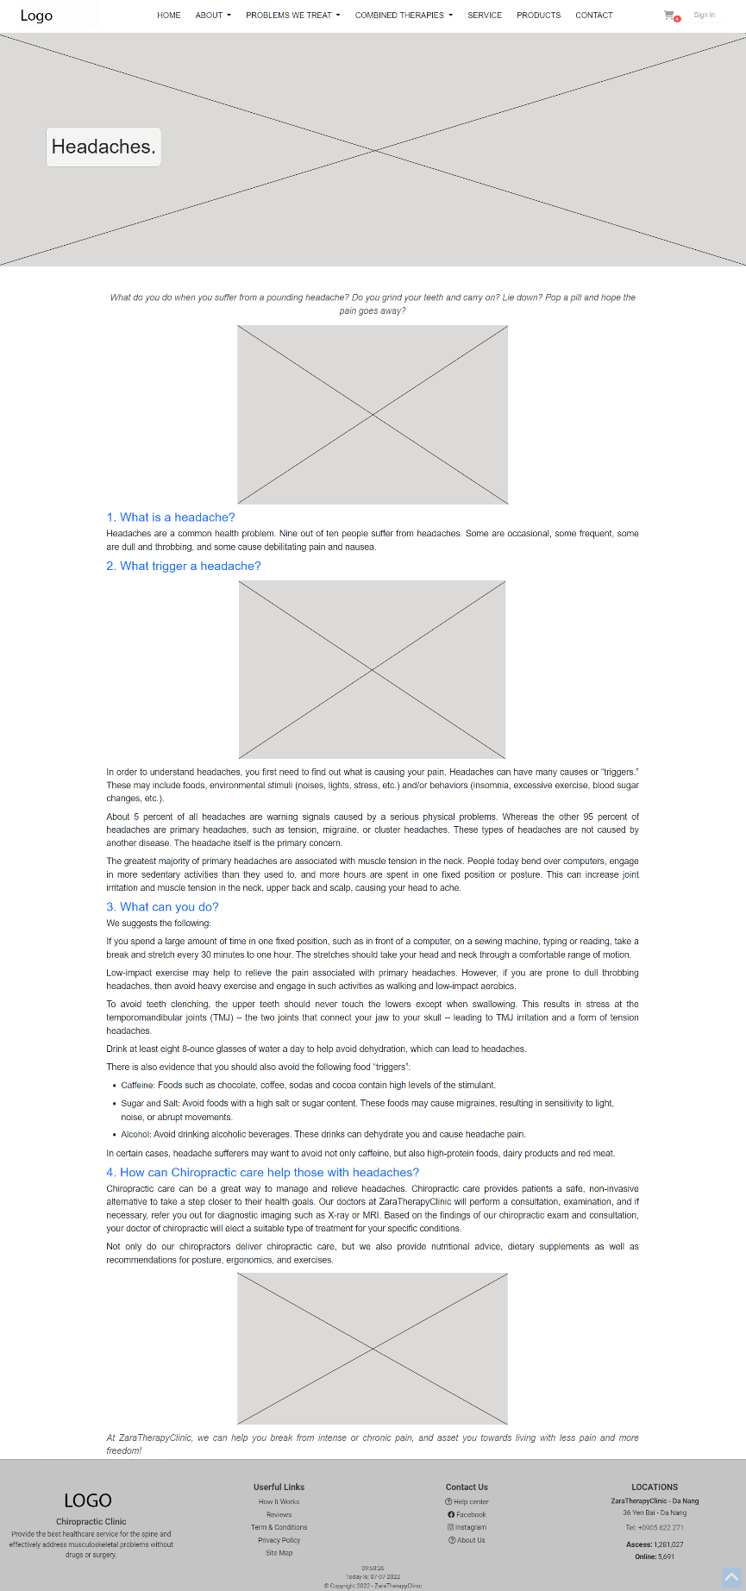
HOME ABOUT US PROBLEM WE TREAT SERVICE PRODUCTS CONTACT
Combined Therapies detail page layout

Slide 17
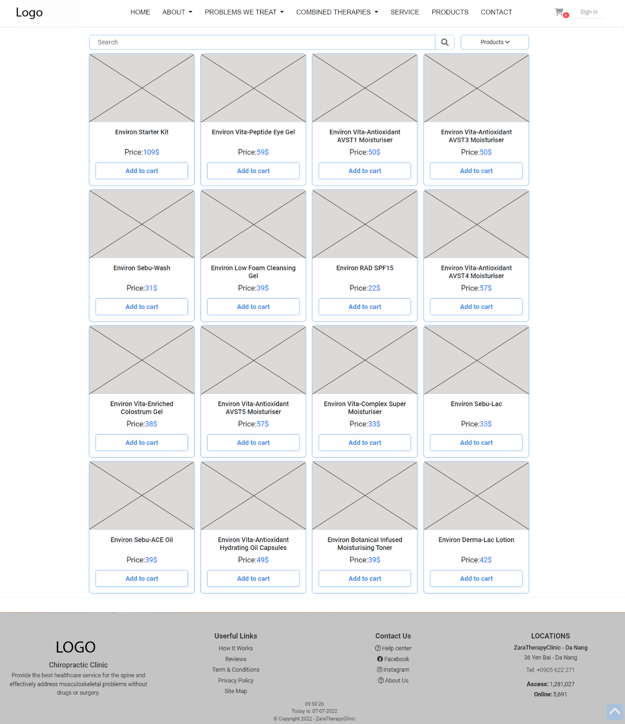
HOME ABOUT US PROBLEM WE TREAT SERVICE PRODUCTS CONTACT
Products page layout

Slide 18
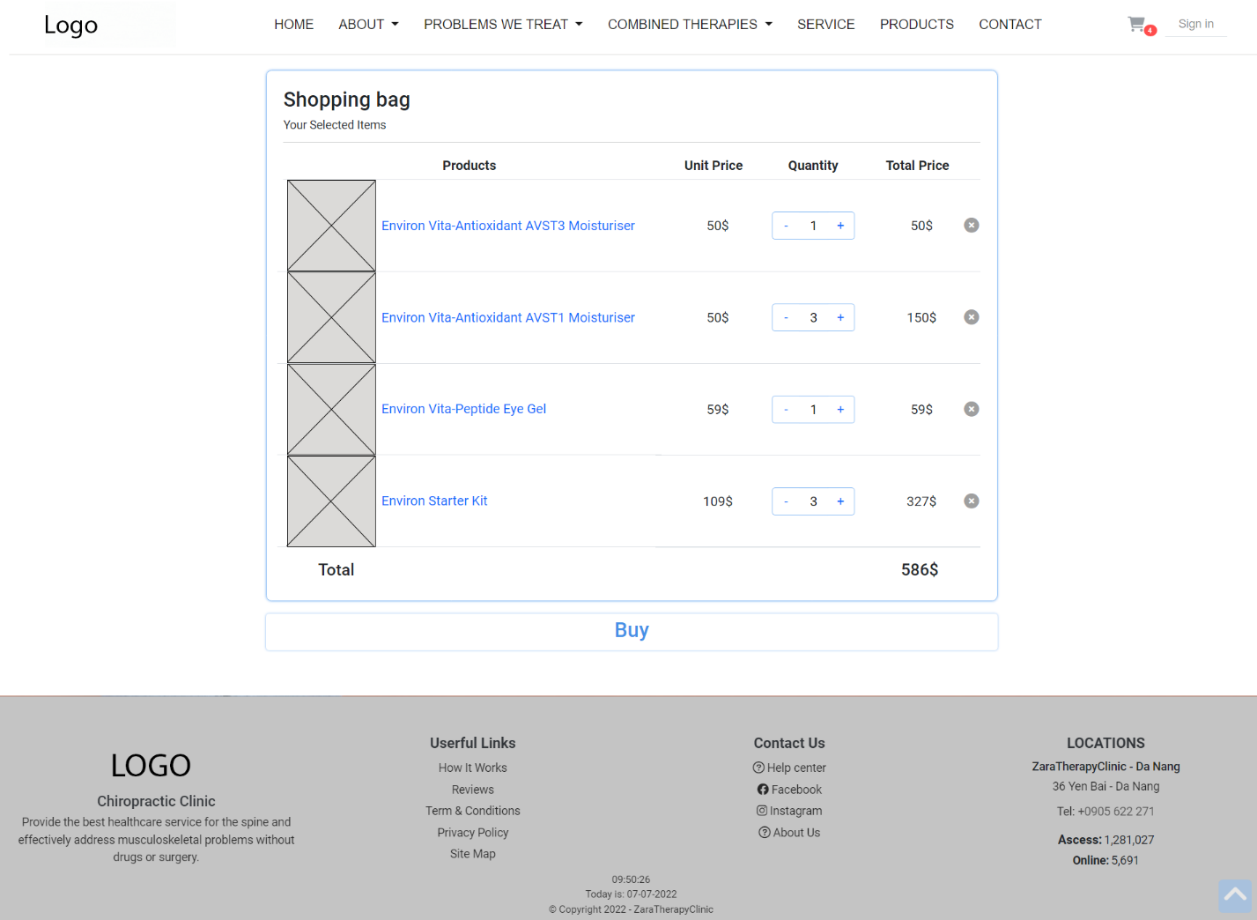
HOME ABOUT US PROBLEM WE TREAT SERVICE PRODUCTS CONTACT
Cart page layout

Slide 19
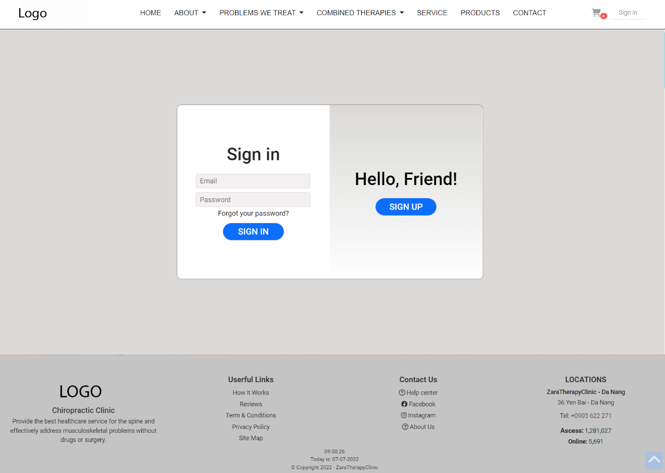
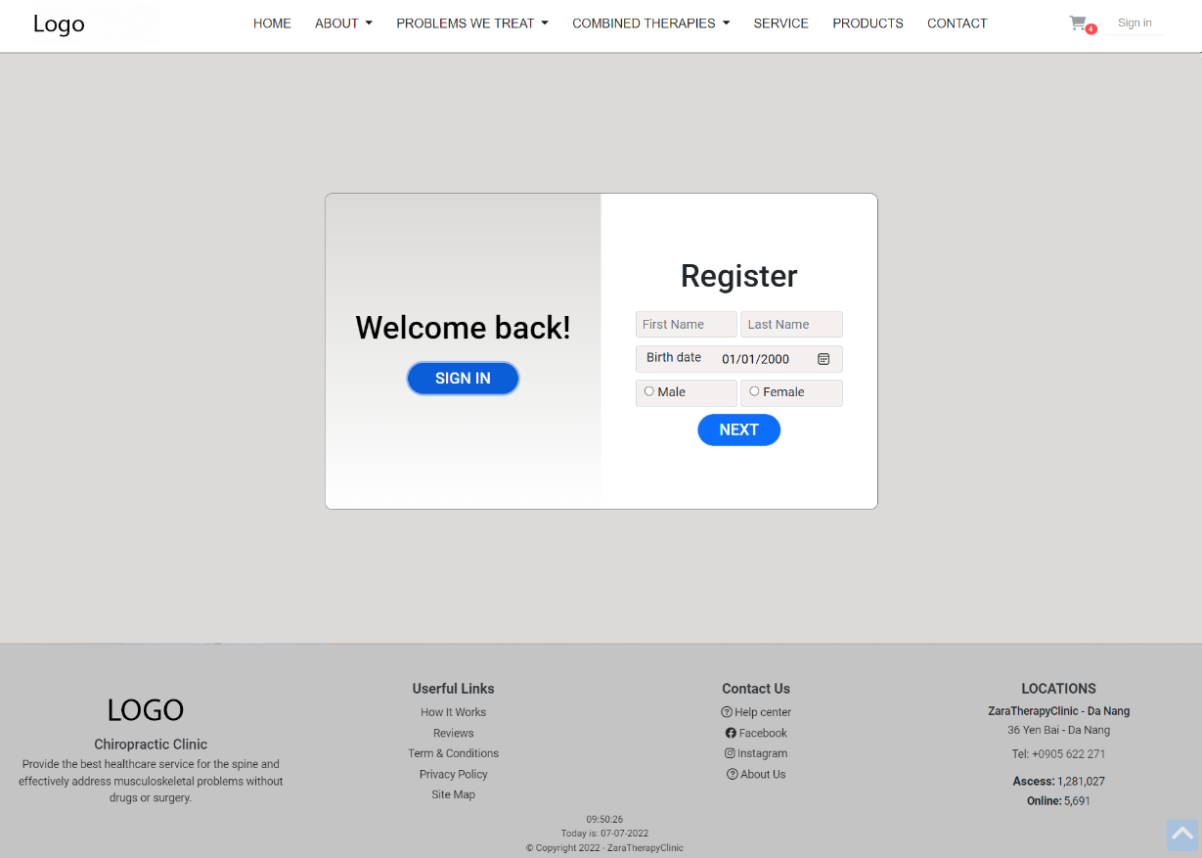
HOME ABOUT US PROBLEM WE TREAT SERVICE PRODUCTS CONTACT
Login/ Sign up layout

Slide 20
HOME ABOUT US PROBLEM WE TREAT SERVICE PRODUCTS CONTACT
IV
Technical

Slide 21
HOME ABOUT US PROBLEM WE TREAT SERVICE PRODUCTS CONTACT
HTML5 & CSS3.
AOS
Owl carousel
Responsive Bootstrap
Validation for bootstrap.
JQuery & JavaScript.
AJAX and JSON
Local Storage
Material for bootstrap:
Material for bootstrap:
JS popover.
JS Scrollspy.
Modal.
BootStrap Carousel.
Button.
Form.
Bootstrap Grid
…….

Slide 22
HOME ABOUT US PROBLEM WE TREAT SERVICE PRODUCTS CONTACT
Advantages, disadvantages and oriented development
V

Slide 23
HOME ABOUT US PROBLEM WE TREAT SERVICE PRODUCTS CONTACT
IV
Advantages
Users can read and study diseases and cures through physical therapy with only one device with an internet connection.
Diverse information, easy searches.
The web app interface is simple, not too complicated for users

Slide 24
HOME ABOUT US PROBLEM WE TREAT SERVICE PRODUCTS CONTACT
IV
Disadvantages
Due to the limitations of time and besides that they are not equipped with adequate knowledge and experience. Therefore, we can not make a complete web app with a database.
The amount of knowledge about diseases and physiotherapy methods is still small. Therefore, it is not possible to select the article quality as well as the content suitable for each category.

Slide 25
HOME ABOUT US PROBLEM WE TREAT SERVICE PRODUCTS CONTACT
IV
Oriented development
In the future, when we have earned enough knowledge required, we really want to improve the work of our unfinished, to perfect and professional web developers, creating excitement inspiration when accessing the web.
Create a complete database of content, as well as images and videos, to develop into a dynamic website.

Slide 26
HOME ABOUT US PROBLEM WE TREAT SERVICE PRODUCTS CONTACT
VI
Gui of website

Slide 27
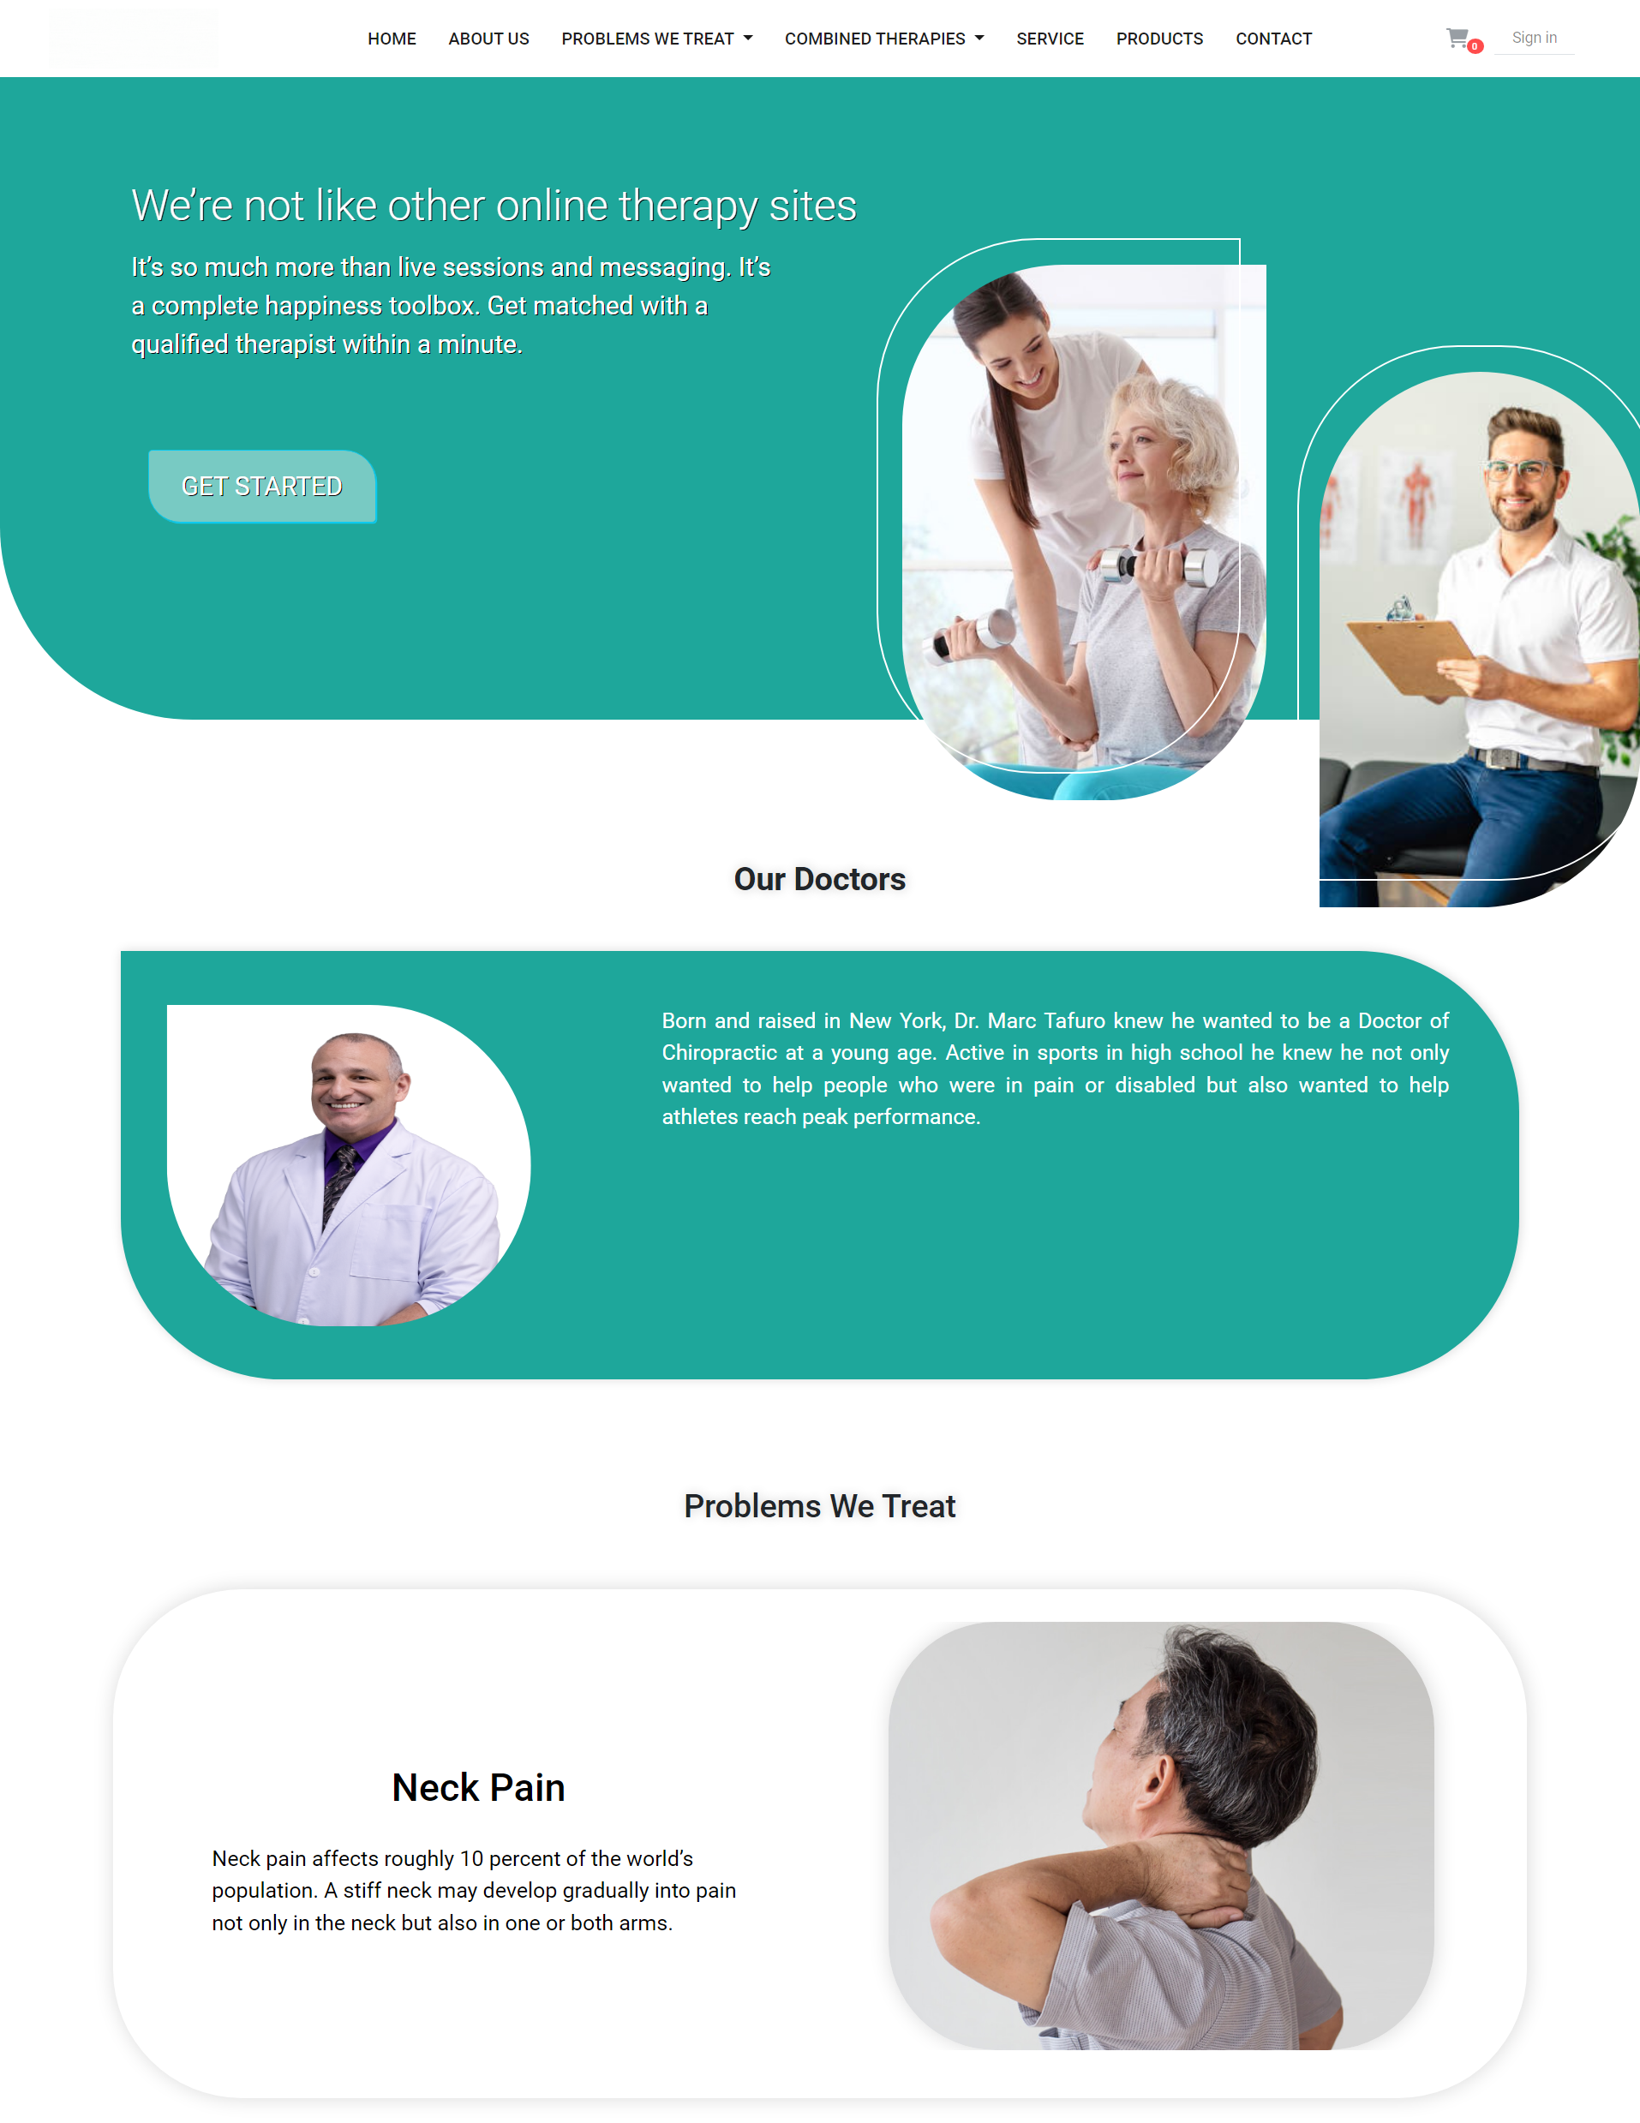
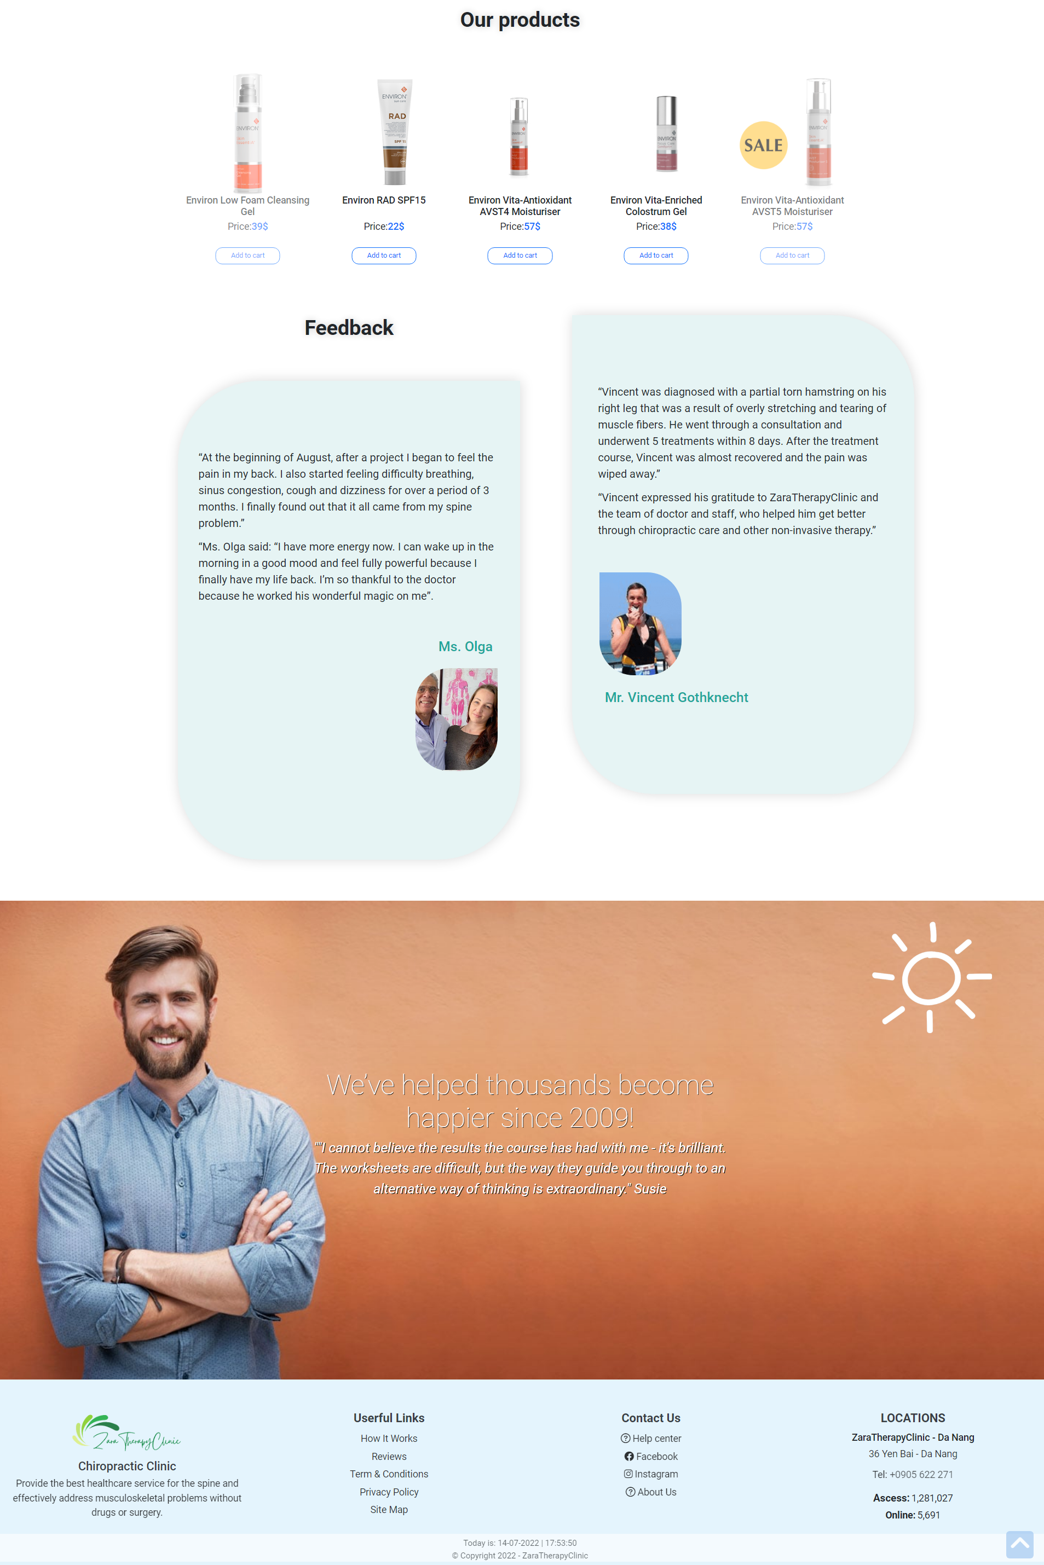

HOME ABOUT US PROBLEM WE TREAT SERVICE PRODUCTS CONTACT
Home page

Slide 28
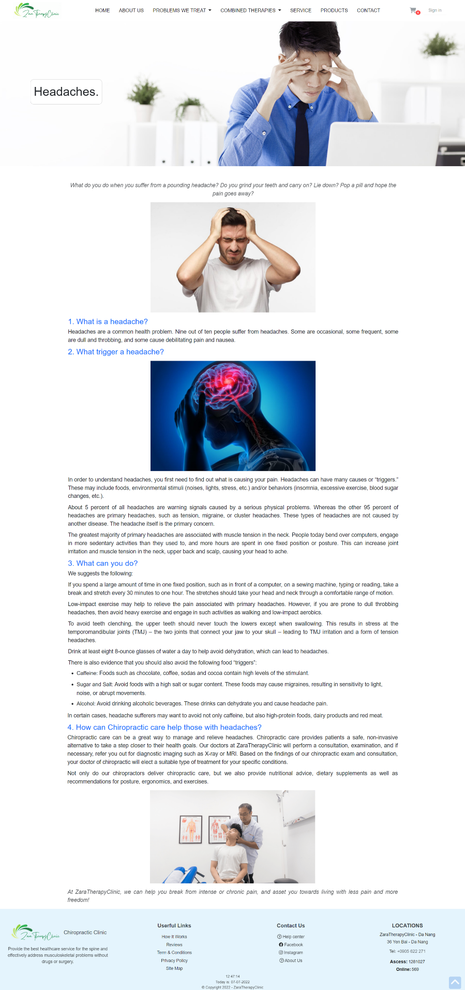
HOME ABOUT US PROBLEM WE TREAT SERVICE PRODUCTS CONTACT
Problem we treat detail page

Slide 29
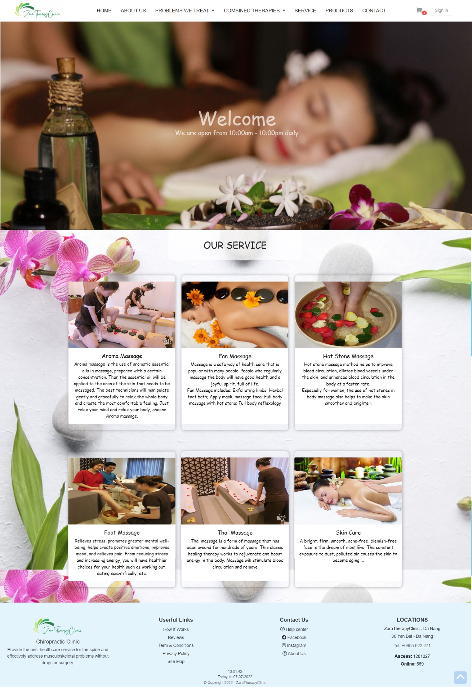
HOME ABOUT US PROBLEM WE TREAT SERVICE PRODUCTS CONTACT
Service page

Slide 30
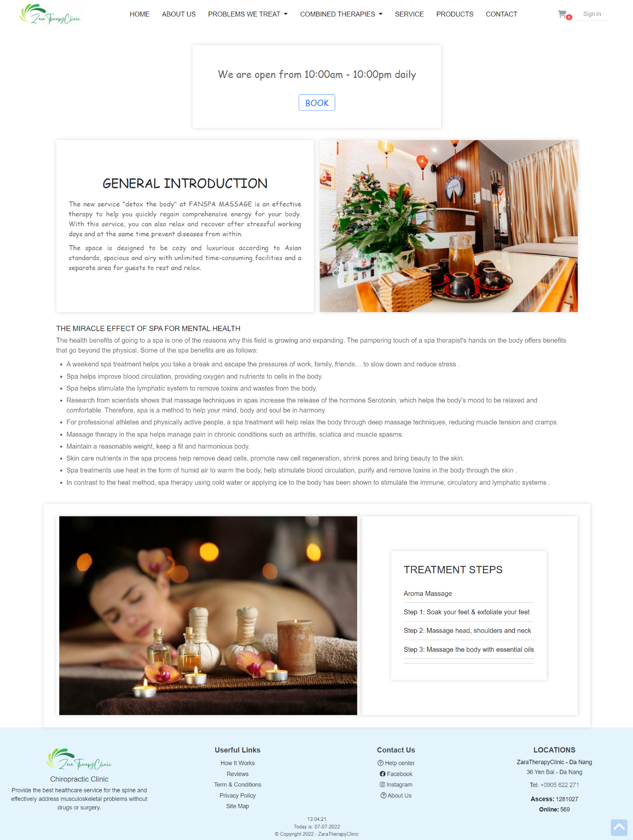
HOME ABOUT US PROBLEM WE TREAT SERVICE PRODUCTS CONTACT
Service detail page

Slide 31
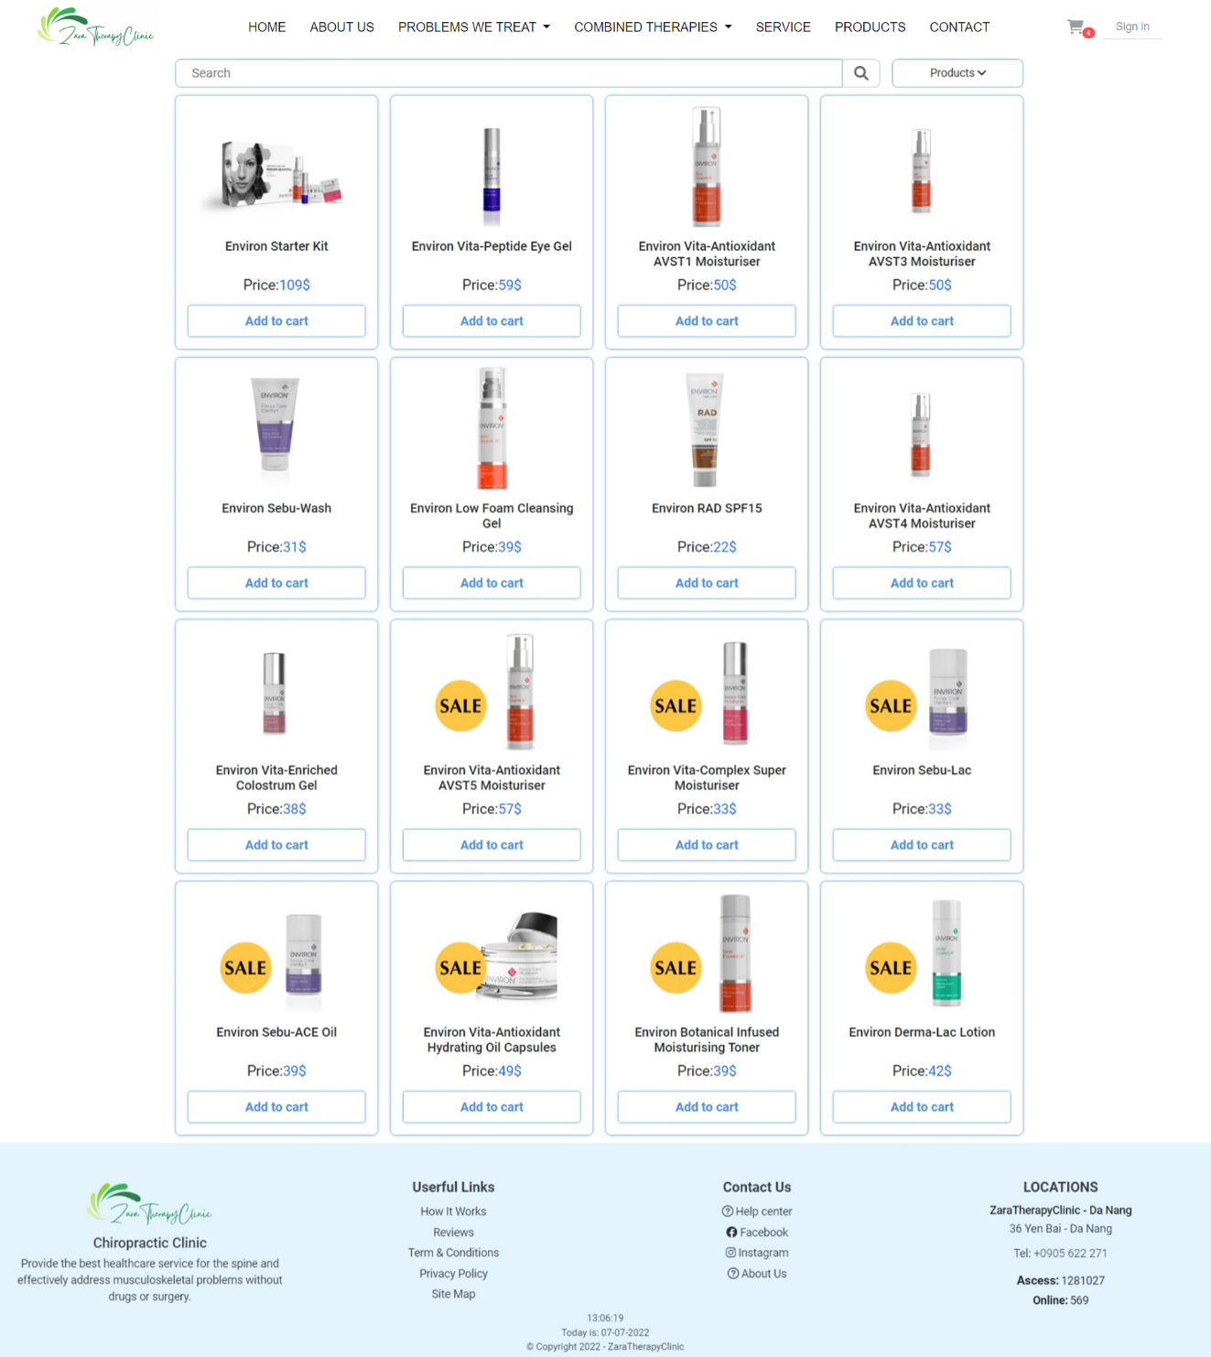
HOME ABOUT US PROBLEM WE TREAT SERVICE PRODUCTS CONTACT
Products page

Slide 32
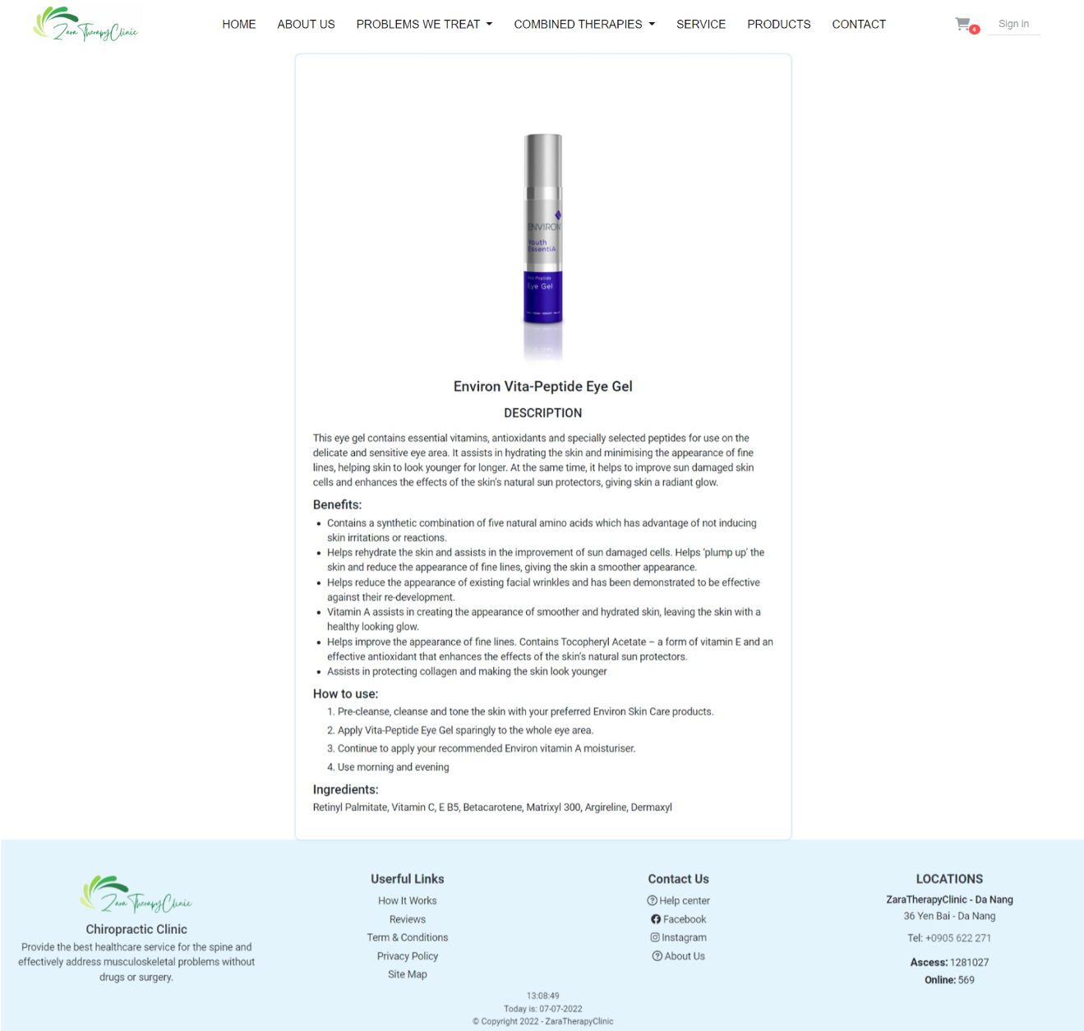
HOME ABOUT US PROBLEM WE TREAT SERVICE PRODUCTS CONTACT
Products detail page

Slide 33
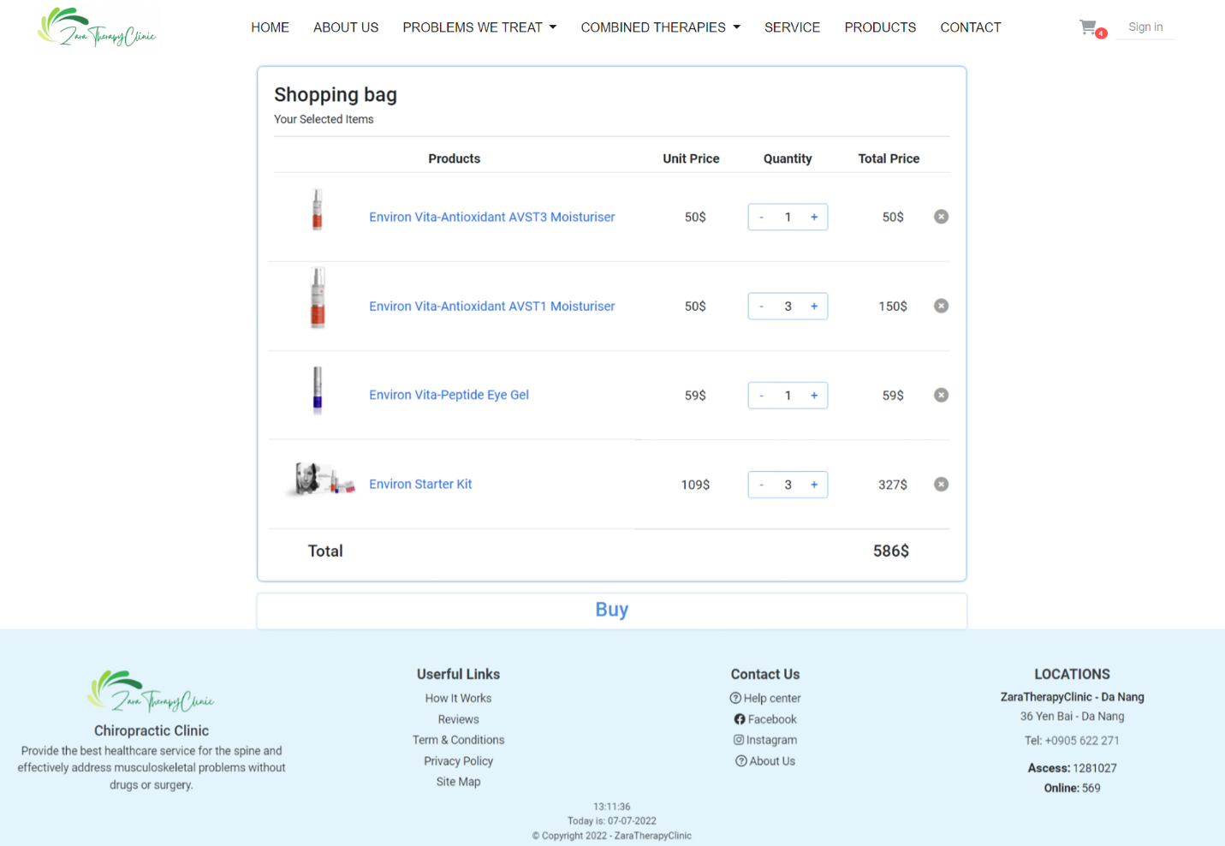
HOME ABOUT US PROBLEM WE TREAT SERVICE PRODUCTS CONTACT
Cart page

Slide 34
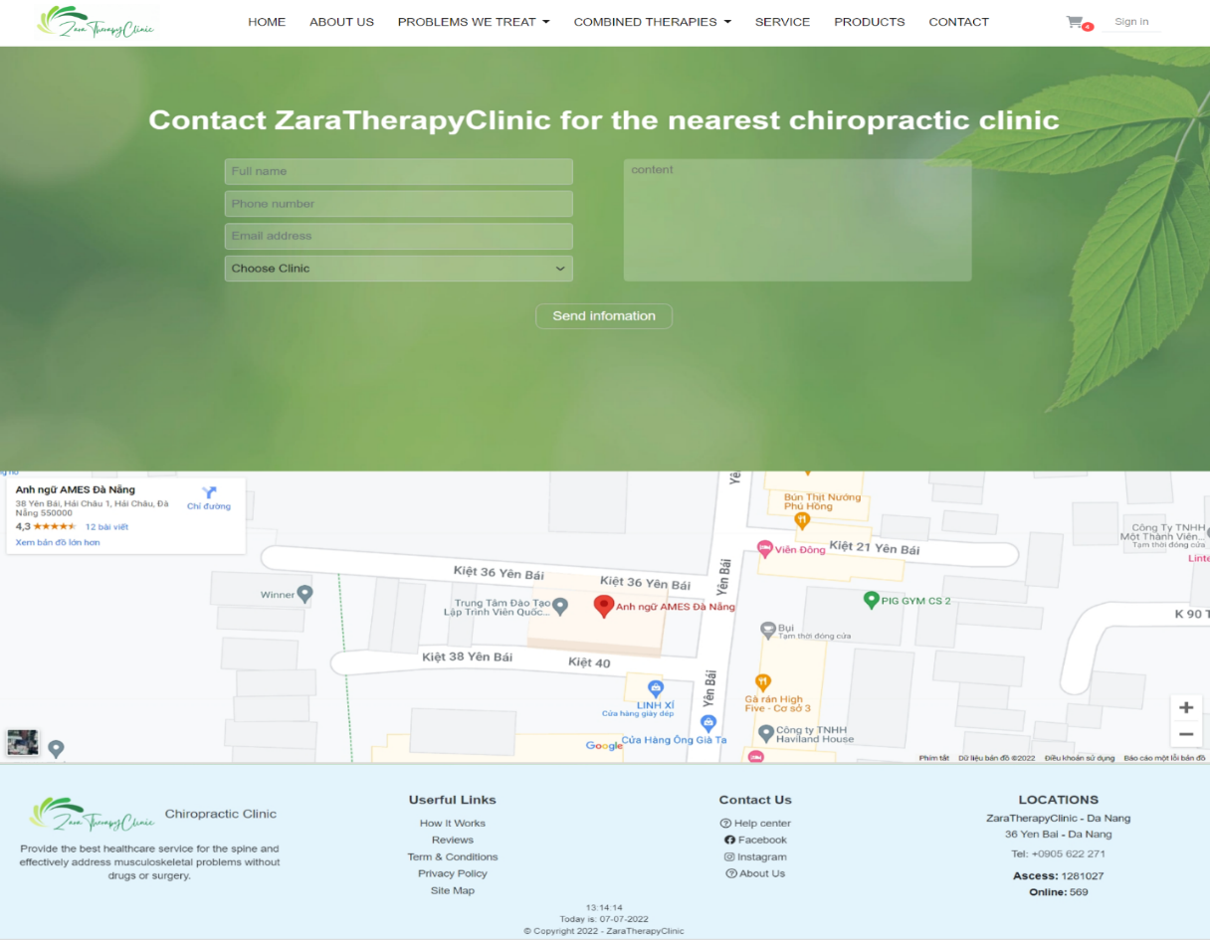
HOME ABOUT US PROBLEM WE TREAT SERVICE PRODUCTS CONTACT
Contact page

Slide 35
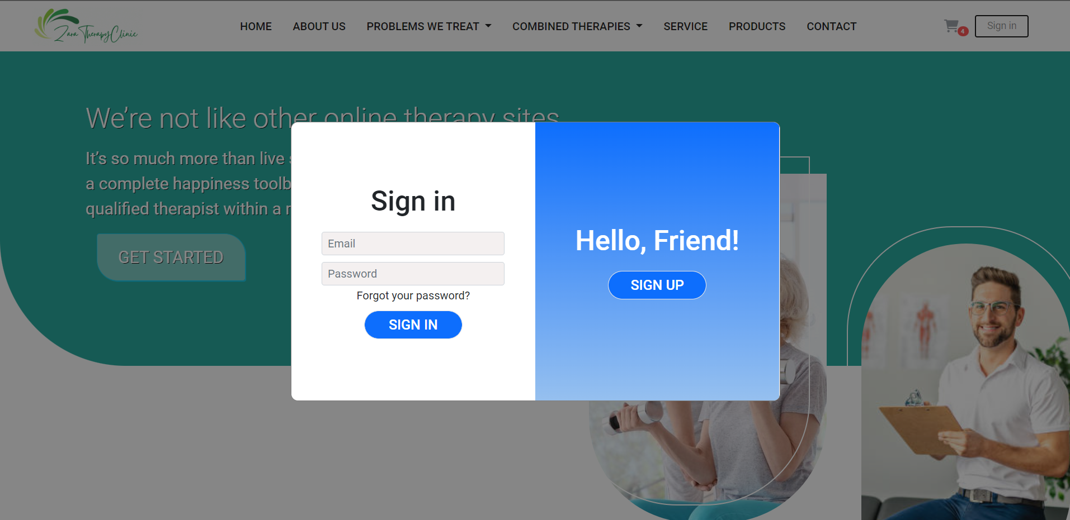
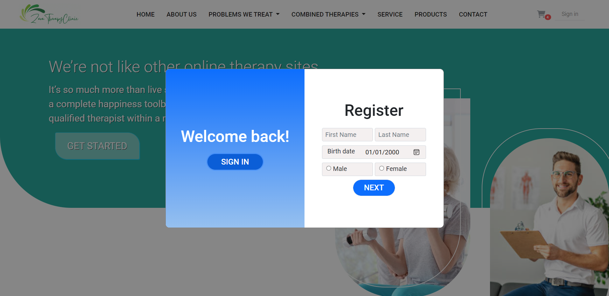
HOME ABOUT US PROBLEM WE TREAT SERVICE PRODUCTS CONTACT
Login/ Sign up layout

Slide 36
HOME ABOUT US PROBLEM WE TREAT SERVICE PRODUCTS CONTACT
VII
Referencs

Slide 37
HOME ABOUT US PROBLEM WE TREAT SERVICE PRODUCTS CONTACT
We consulted information on the websites:
[1] https://jquery.com/
[2] http://www.w3schools.com/
[3] http://www.getbootstrap.com/
[4] https://ngoanhhao.github.io/ZaraTherapyClinic-B172/

Slide 38
HOME ABOUT US PROBLEM WE TREAT SERVICE PRODUCTS CONTACT
THANKS FOR WATCHING!

